Slide 1
AI Assisted Tele-Medicine KIOSK for Rural India
PIP4004 Capstone Project
Review-1
Batch Number: CAI-G19
Roll Number | Student Name
20211CAI0080 | R KESHAV
20211CAI0087 | RAKSHITHA KT
20211CAI0109 | S SRINIVAS
20211CAI0187 | PREM JE KALISTER
Under the Supervision of
Dr. AKSHATHA Y
Assistant Professor
School of Computer Science and Engineering
Presidency University
Name of the Program: B.Tech Computer Science and Engineering (AI & ML)
Name of the HoD: Dr. Zafar Ali Khan
Name of the Program Project Coordinator: Dr. Afroz Pasha
Name of the School Project Coordinators: Dr. Sampath A K / Dr. Abdul Khadar A / Mr. Md Ziaur Rahman

Slide 2
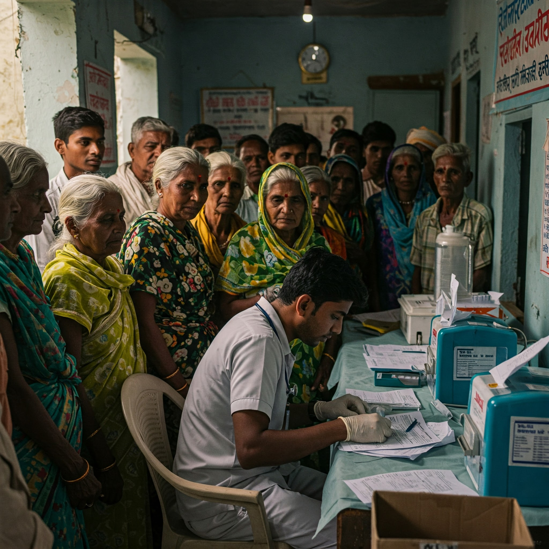
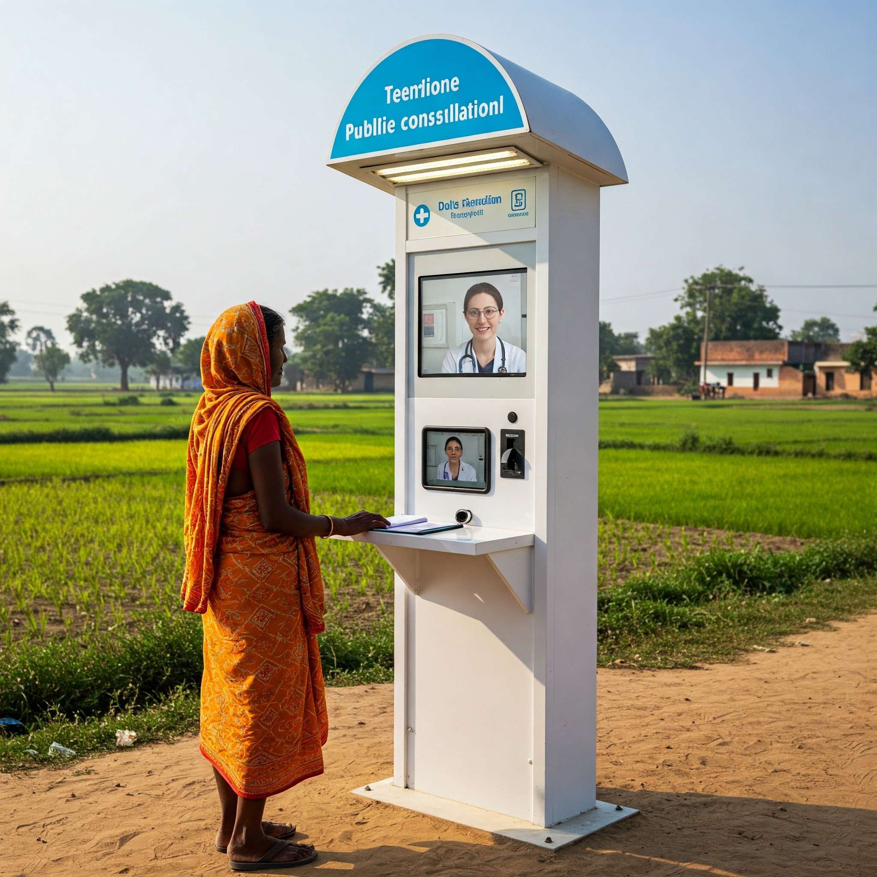
Content
Problem Statement
Github Link
Analysis of Problem Statement
Timeline of the Project
References

Slide 3
Problem Statement Number: PSCS48
Organization: Government Of India
Category (Hardware / Software / Both) : Software
Problem Description: Health care in rural India is still an unresolved area that demands improved and innovative solutions. The easy availability and access to expert doctors, according to the medical condition of the individual/patient can be provided by the AI-assisted telemedicine robotic Kiosk that can be set up anywhere in the village. Individuals may mark their identity through the biometric scanner. A robot may speak to the individual, enquiring about the illness. Later, the individual will be directed online to an expert doctor, via e-sanjeevani App. After the consultation, medicines and other associated services can be provided to them through the local Asha worker without any delay.
Difficulty Level: Complex

Slide 4
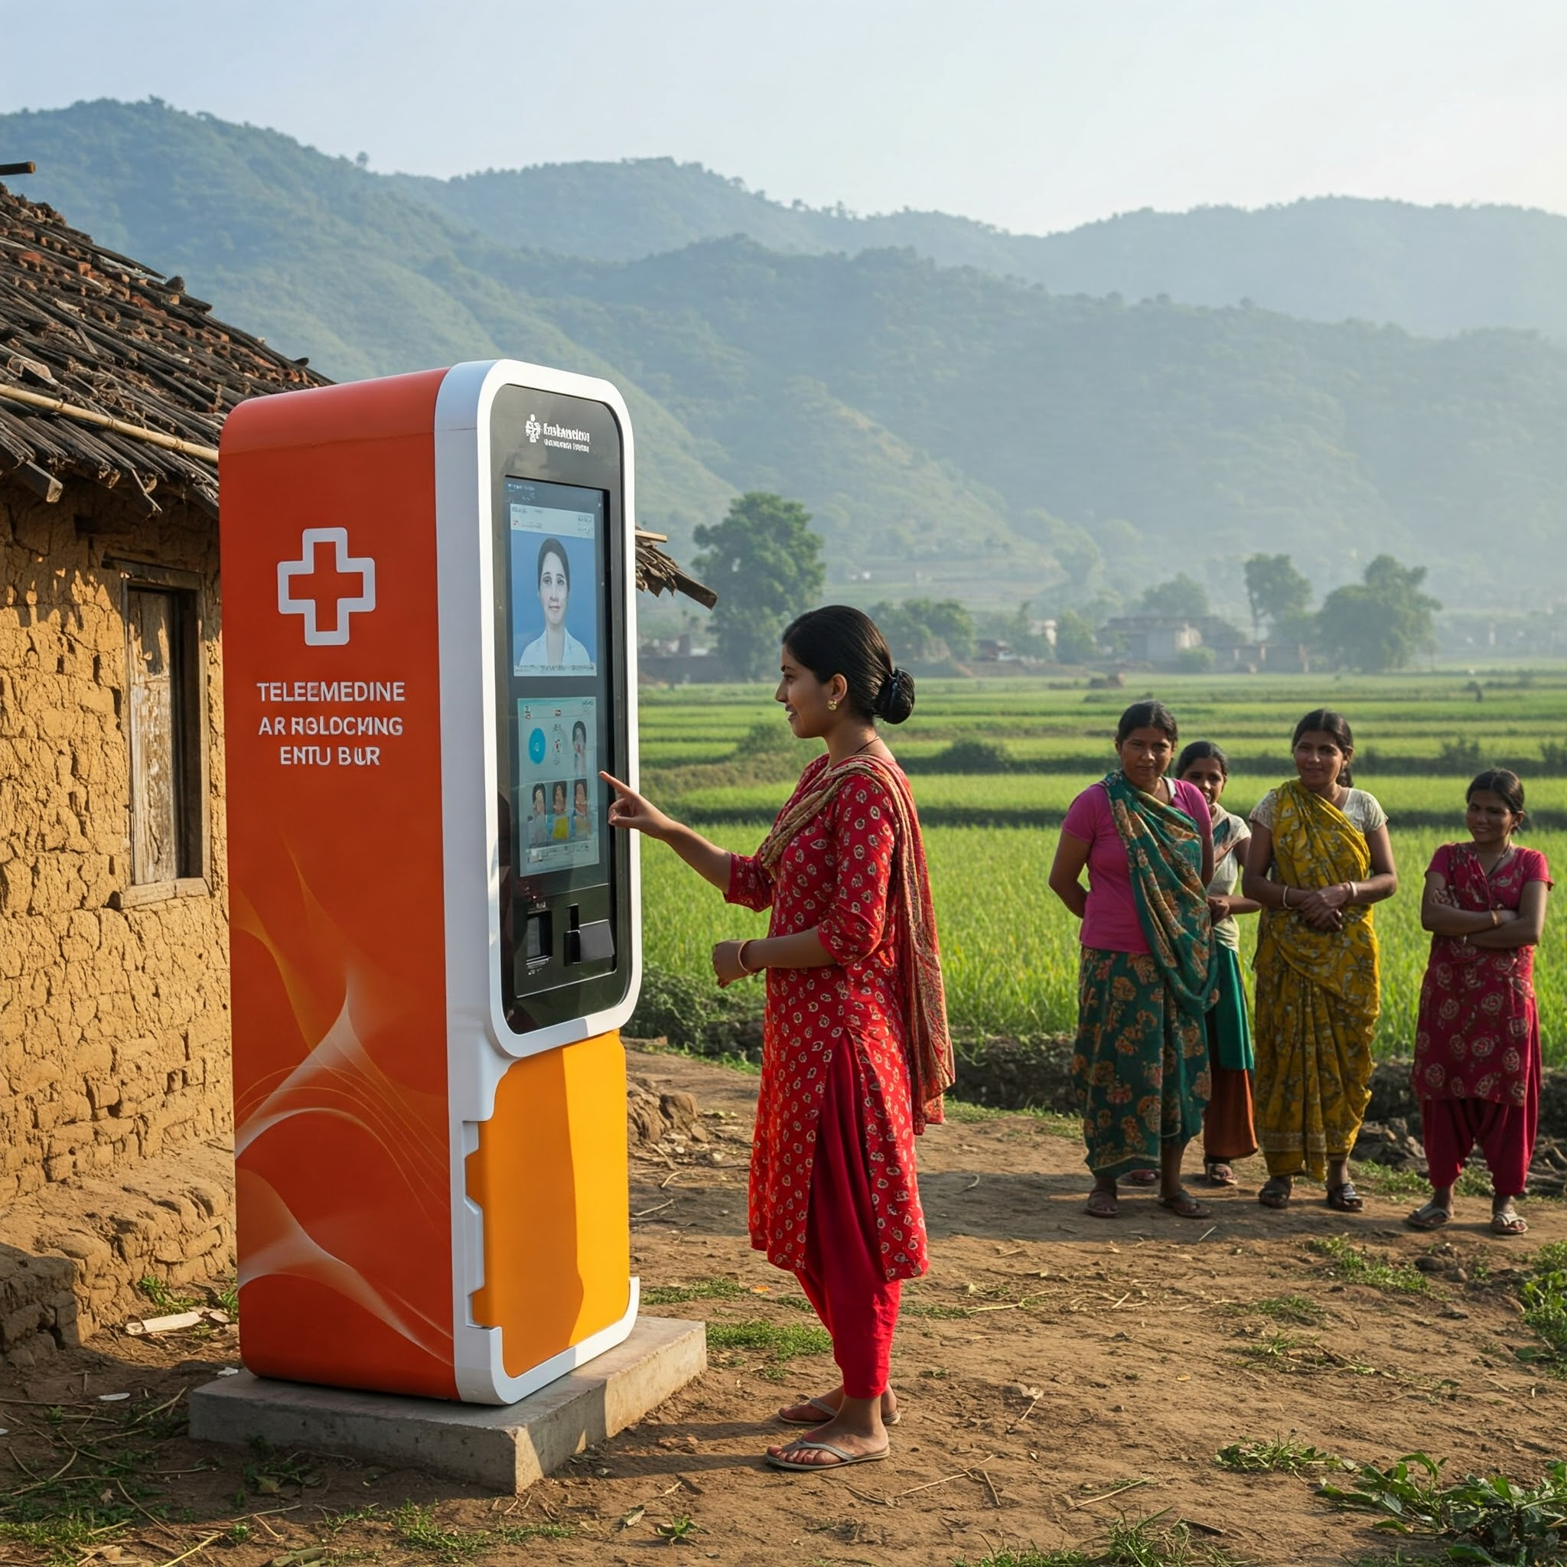
Github Link
The Github link provided should have public access permission.
Github Link
https://github.com/sakesrinivas/telemedicine-kiosk

Slide 5
Analysis of Problem Statement
Technology Stack Components: Agriculture, FoodTech & Rural Development
Languages: Python
Libraries and Frameworks: OpenCV (for camera-based biometric authentication )
WhisperAI, pyttsx3 (for voice-based interaction)
Translator(Llama 70B)
transformers, torch (for AI-driven diagnosis and chatbot interaction)
FastAPI/Flask (for backend API development)
Large Language Models: Llama3,Gemma,Mistral,Deep-Seek.
Database: MongoDB
Interface: Streamlit / HTML, CSS, JavaScript

Slide 6
Analysis of Problem Statement (contd...)
Software and Hardware Requirements:
Operating System: Windows 10/11
RAM: Minimum 16GB
Processor: Intel i7/AMD Ryzen 7 and Above
GPU: Nvidia-12GB VRAM and above
IDE: Jupyter Notebook, Visual Studio Code, GitHub Codespaces.
Cloud Computing: Google Collaboratory

Slide 7
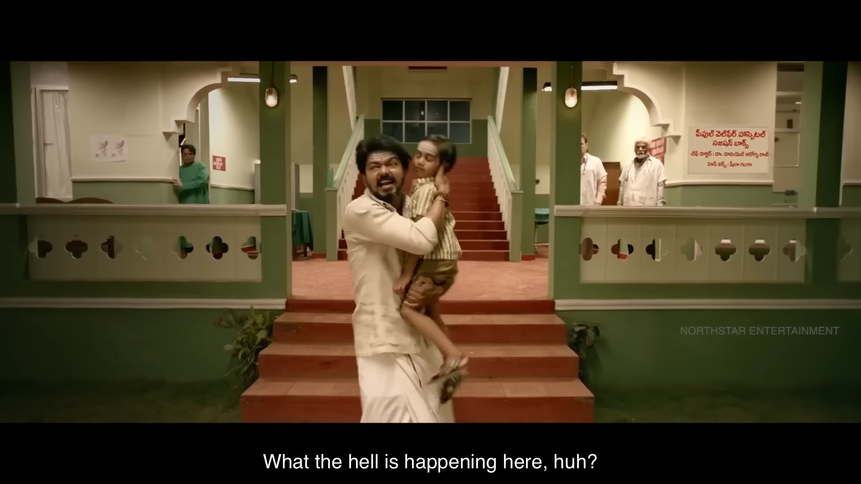
Analysis of Problem Statement (contd...)
Doctors in rural India face significant challenges in providing quality healthcare due to limited accessibility and infrastructure. While telemedicine platforms like e-Sanjeevani enable remote consultations, several issues hinder their effectiveness in rural settings.
Concerning issues:
Limited Access to Expert Doctors: Rural patients struggle to connect with specialists due to geographical and technological barriers.
Lack of Immediate Assistance: Many individuals require preliminary assessment and guidance before an online consultation, which is currently unavailable.
Language & Digital Literacy Barriers: Patients in rural areas may find it difficult to navigate telemedicine platforms, especially when dealing with complex medical instructions.
Delayed Medicine Delivery: After consultation, ensuring timely medicine distribution remains a challenge, affecting patient recovery.
Inconsistent Patient Records: Many rural patients lack digital health records, making it difficult for doctors to track medical history effectively.

Slide 8
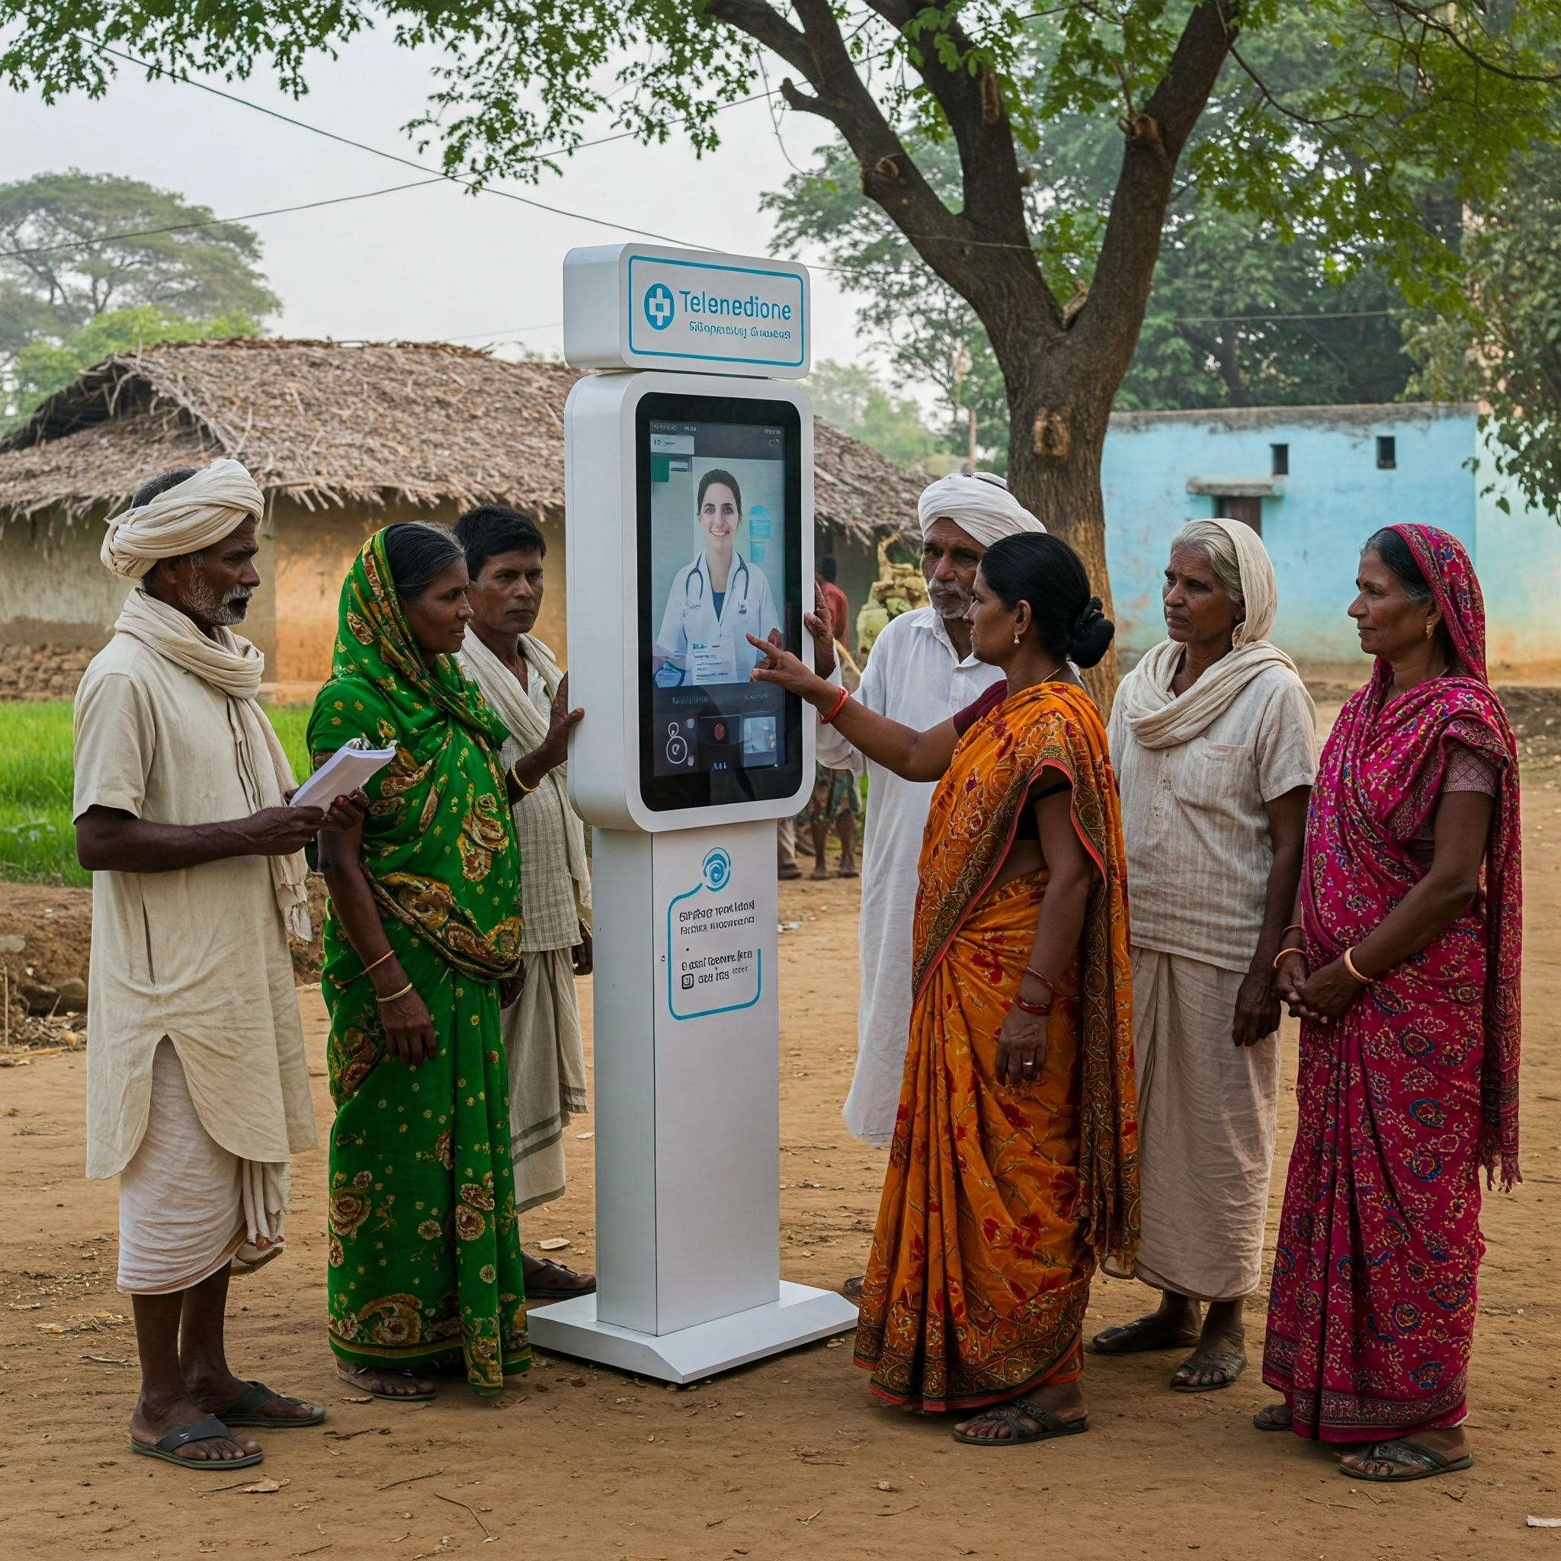
Analysis of Problem Statement (contd...)
Proposed Solution:
AI Conversational Chatbot for Patient Interaction & Pre-Diagnosis
Patients register using biometric authentication (Face Recognition/ Mobile OTP).
A virtual assistant interacts in regional languages, collecting symptoms via voice-based preliminary assessments.
Seamless Doctor Consultation via e-Sanjeevani
AI generates predicted possible disease and illnesses and recommends to choose between medical departments to book a session with doctor .
Patients connect with specialist doctors in real-time through the e-Sanjeevani platform, ensuring expert consultation.
Medicine & Treatment Accessibility
Digital prescriptions are sent to ASHA workers for timely medicine delivery to patients.
(Future Scope) Automated medicine dispensers at kiosks for immediate access to essential medications.

Slide 9
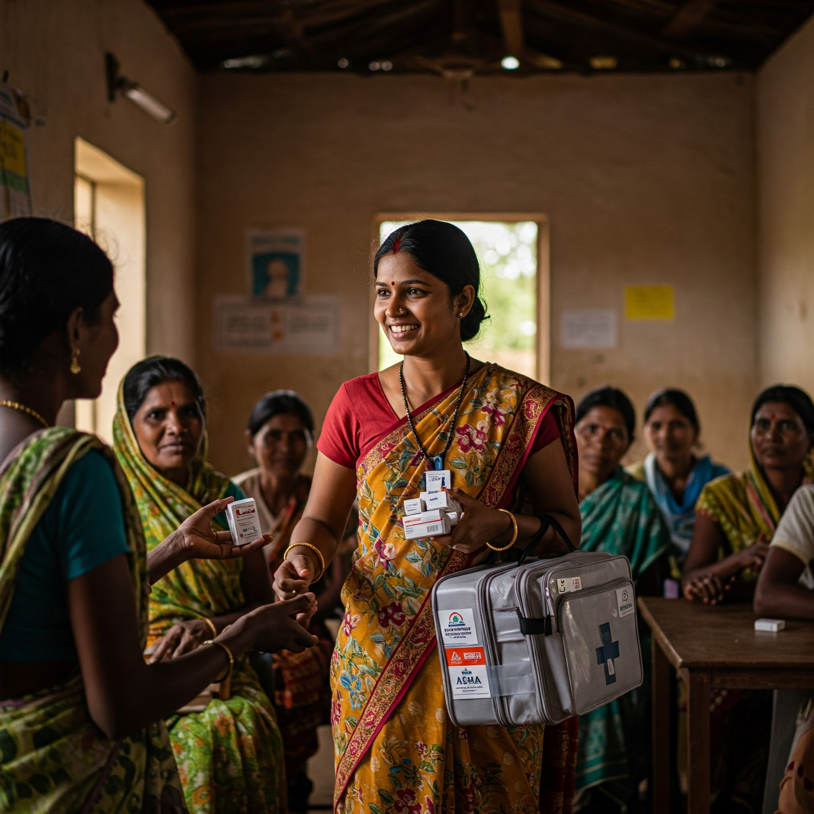
Analysis of Problem Statement (contd...)
Outcome:
Increased Access to Healthcare – Rural populations gain improved access to expert doctors, reducing dependency on distant hospitals.
Reduced Consultation & Treatment Delays – AI-assisted triage, real-time virtual consultations, and fast medicine delivery ensure quicker treatment.
Efficient Medical Record-Keeping – Cloud-based digital health records improve patient history tracking, enabling better long-term care.

Slide 10
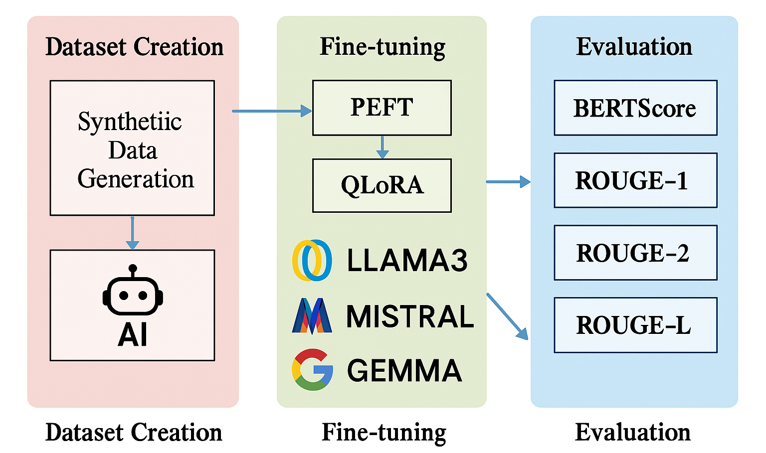
FLOWCHART

Slide 11
Timeline of the Project (Gantt Chart)
Phase 1(Feb1 – Feb28)
Phase 2(March1 –March17)
Phase 3(April1-April17)
Requirements Gathering
System Architecture Design
Prototype User Interface Design
Technology Selection & Tooling
Creating a training dataset
Fine-Tuning LLM and integrating Langchain
LLM Translator
Backend Development & API Integration
System Testing & Debugging
User Acceptance Testing (UAT)
Deployment & Scaling
Training & Support Setup

Slide 12
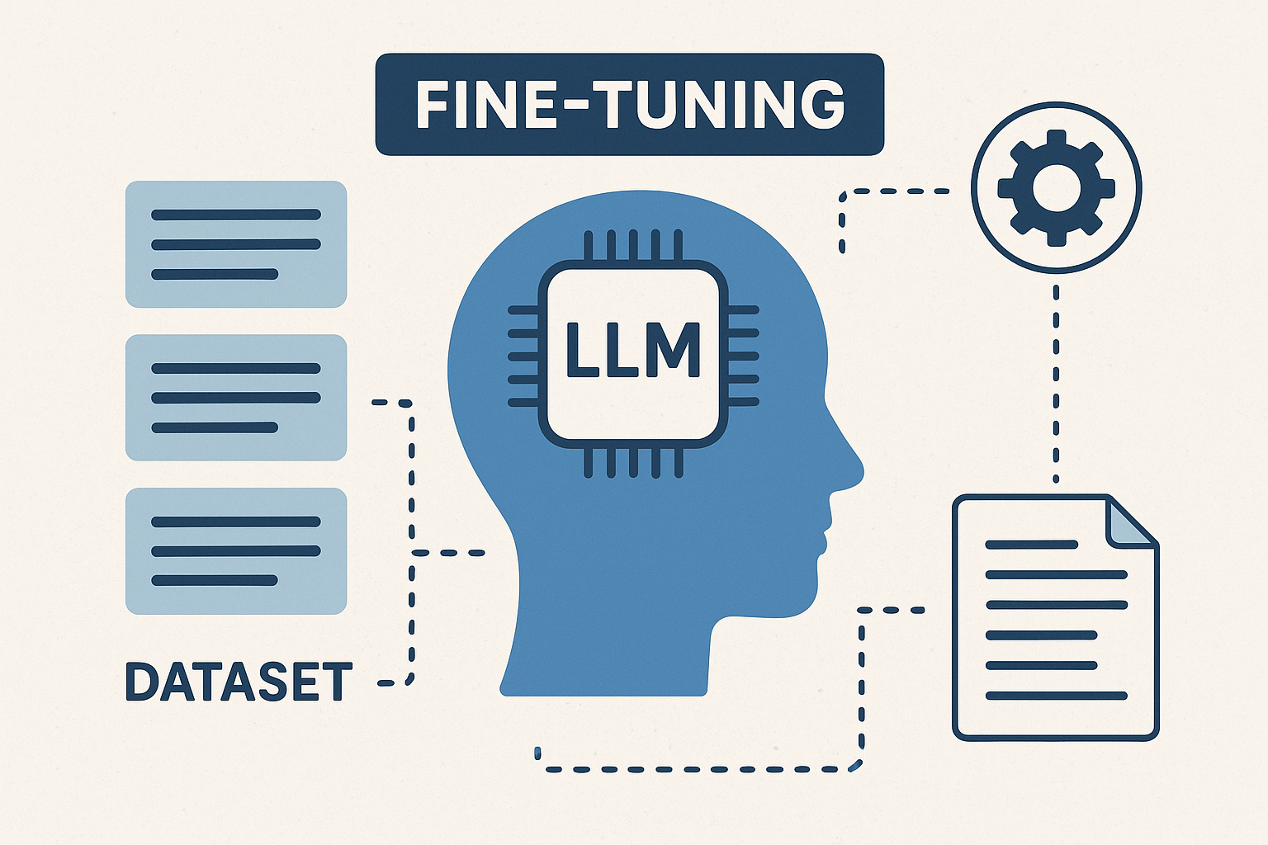
Why Finetuning?
Fine-tuning a Large Language Model (LLM) is essential in the context of this study because general-purpose models like GPT or BERT are not specifically trained to handle the nuanced, high-stakes nature of medical conversations. The paper introduces MediTalk300, a fine-tuned version of the Mistral 7B model, tailored using domain-specific dialogue data covering 300+ commonly occurring diseases in India. This fine-tuning allows the model to maintain semantic coherence, understand medical terminology and provide contextually accurate and relevant responses—capabilities that generic LLMs lack. Such precision is vital for delivering reliable healthcare advice, especially in rural areas where professional assistance is limited and immediate, accurate responses can significantly impact outcomes.

Slide 13
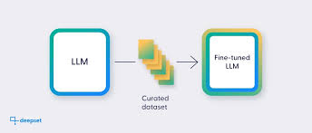
How Finetuning?
What is Fine-Tuning?
Fine-tuning is the process of taking a pre-trained machine learning model- usually trained on a large and general dataset and adapting it to perform well on a specific task or domain by training it further on a smaller, task- specific dataset. This allows the model to retain its general knowledge while learning specialized patters relevant to the new application.
Steps involved in Fine-Tuning
Dataset Creation And Preparation
Preprocessing and Formatting
Fine-Tuning Techniques

Slide 14

Dataset Creation and Preparation
The fine-tuning process began with the construction of a domain-specific dataset called MediTalk300, which includes 1,752 synthetic doctor-patient dialogue pairs focused on 300+ commonly occurring diseases in India. Since publicly available medical dialogue datasets in conversational format were scarce, the authors generated this dataset using Gemini AI and formatted it in ShareGPT style. Each conversation was designed to simulate realistic medical interactions, containing questions, diagnostic guidance, and treatment suggestions for diseases such as malaria, diabetes, TB, and depression. This ensured that the model could learn context-aware, semantically rich exchanges typical of healthcare consultations.

Slide 15
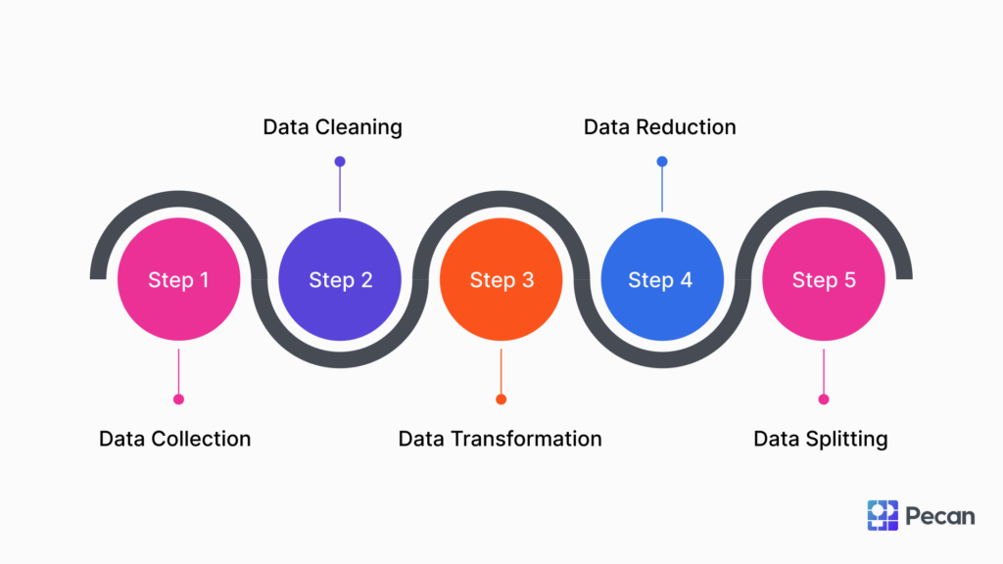
Preprocessing and Formatting
Before fine-tuning, the dataset underwent several preprocessing steps to standardize it for instruction-tuned models. The initial ShareGPT-style messages were normalized using the standardize_sharegpt() function to a schema that clearly distinguished roles (user and assistant).
This was followed by tokenization using a chat template that inserted special tokens (e.g., <|begin_of_text|>, <|start_header_id|>) to encode dialogue structure. This formatting helped the model learn conversational flow and role-switching behavior, which is critical for multi-turn, human-like medical conversations.

Slide 16
Fine-Tuning Techniques
The authors used a combination of three state-of-the-art fine-tuning strategies to adapt the Mistral 7B model efficiently while minimizing resource requirements:
Parameter-Efficient Fine-Tuning (PEFT): This approach updates only a small, task-specific subset of the model's parameters, while keeping most of the model frozen. It drastically reduces computational overhead and training time, making it ideal for adapting large models on limited hardware. PEFT enables the model to learn domain-specific behaviors without re-training the entire model from scratch.
Quantized Low-Rank Adaptation (QLoRA): QLoRA builds on the Low-Rank Adaptation (LoRA) method by applying 4-bit or 8-bit quantization to compress the model, significantly reducing memory usage without compromising accuracy. It works by introducing trainable low-rank matrices into specific layers, enabling fine-tuning at a much lower precision while still capturing meaningful updates.
Instruction Tuning: This technique involves conditioning the model to follow structured instructions for generating responses. It enhances the model’s ability to understand user intent and maintain task precision—especially crucial in high-risk domains like healthcare. Instruction tuning was used to ensure the chatbot delivers consistent and medically relevant responses by adhering to a predefined response pattern.

Slide 17
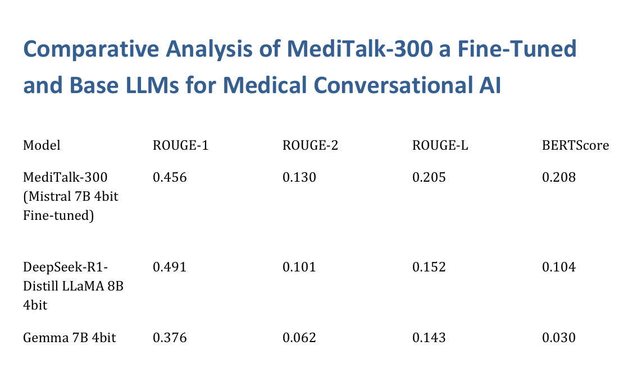
Results
The project evaluates the performance of MediTalk-300, a fine-tuned Mistral 7B model, against base large language models (DeepSeek-R1-Distill LLaMA 8B and Gemma 7B) for medical conversational AI tasks.
Results Summary:
MediTalk-300 achieves higher ROUGE-2, ROUGE-L, and BERTScore compared to the base models, indicating better contextual understanding and coherence in medical dialogue generation.
DeepSeek-R1 has the highest ROUGE-1 score, showing strong lexical similarity but falls short in other metrics.
Gemma 7B underperforms across all metrics, suggesting it is less effective for this specific medical AI task.
Overall, the results suggest that fine-tuning Mistral 7B (MediTalk-300) improves medical conversational AI performance, particularly in producing more coherent and semantically relevant responses.

Slide 18
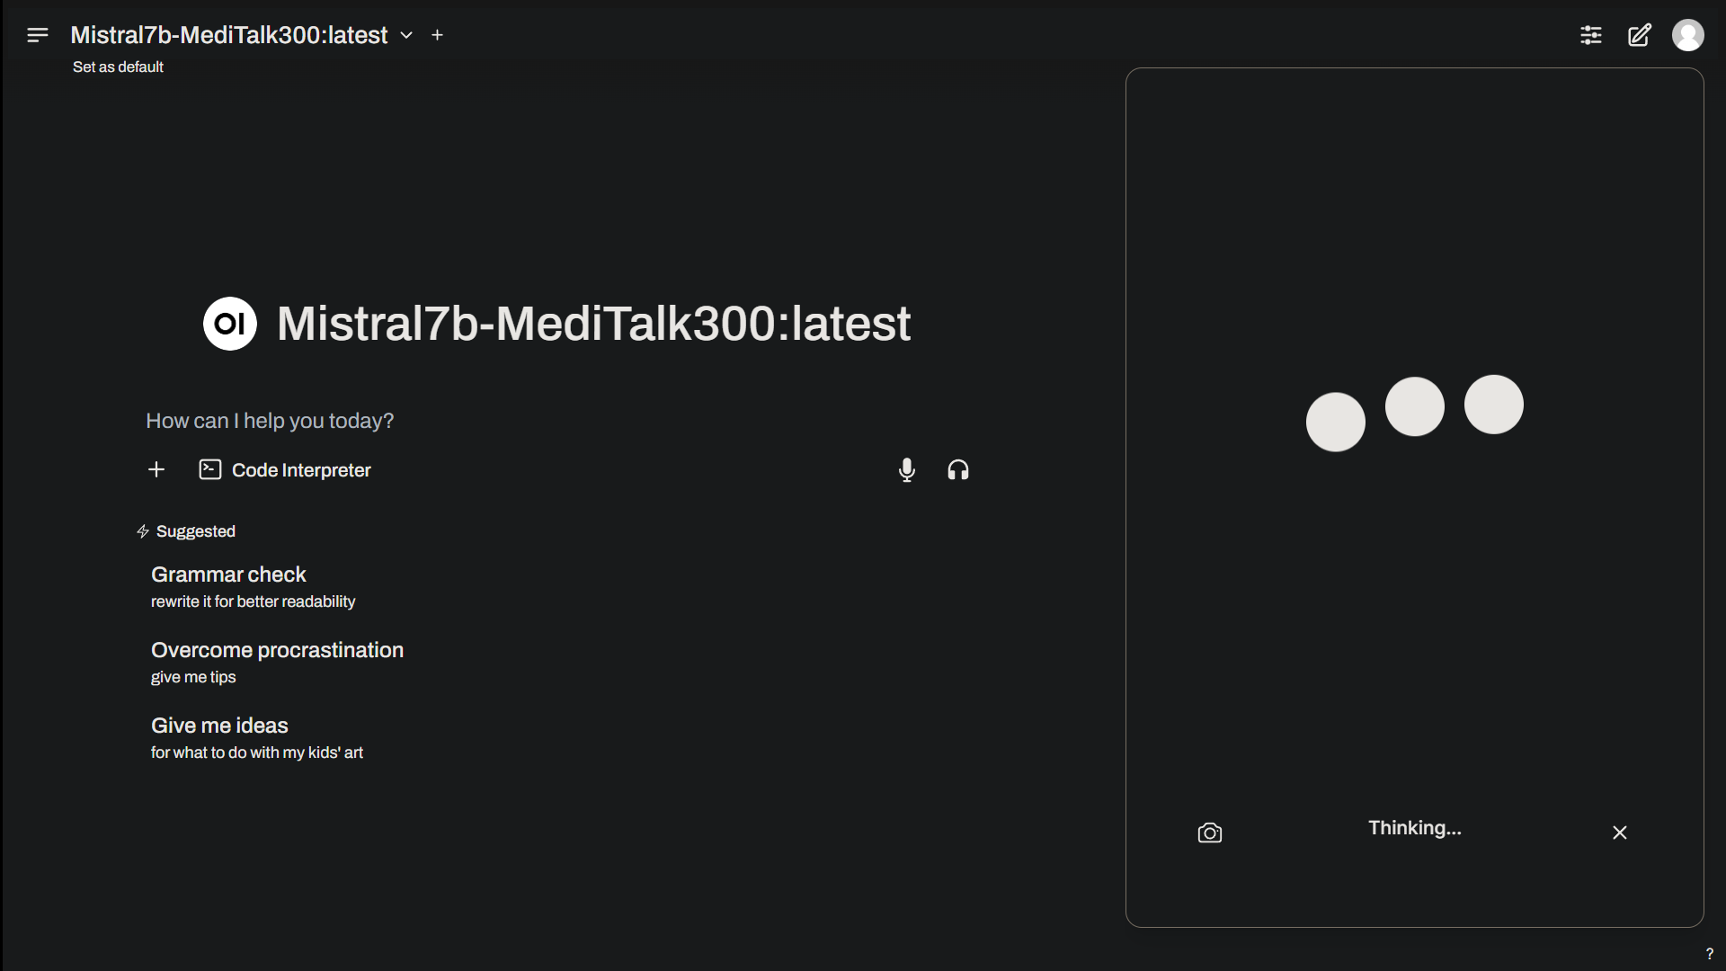
Conclusion
The AI-Assisted Telemedicine Kiosk leverages AI-driven diagnosis through a conversational LLM to provide medical guidance and support in rural India. The implementation of MediTalk-300, a fine-tuned Mistral 7B model, enables effective patient interaction via medical call and chat services, offering symptom analysis and preliminary guidance. The system demonstrates the potential of AI in delivering accessible healthcare support, with future work focusing on expanding disease coverage and integrating automated medicine dispensers for quicker access to essential medications.

Slide 19
References (IEEE Paper format)
1.[Telemed in india]: Kesarwani, Sidheshkumar & Satheesh, Subodh S. (2023). A Narrative Review on Telehealth Services Adoption in Rural Areas and Related Barriers to Telehealth in India - Technological, Regional, Cultural, and Linguistics. The Indian practitioner. 56. 13-21.
2.[Teleblueprint] : Poonsuph, Rattakorn, The Design Blueprint for a Large-Scale Telehealth Platform, International Journal of Telemedicine and Applications, 2022, 8486508, 15 pages, 2022. https://doi.org/10.1155/2022/8486508
3.[TelemedBot]: U. Bharti, D. Bajaj, H. Batra, S. Lalit, S. Lalit and A. Gangwani, "Medbot: Conversational Artificial Intelligence Powered Chatbot for Delivering Tele-Health after COVID-19," 2020 5th International Conference on Communication and Electronics Systems (ICCES), Coimbatore, India, 2020, pp. 870-875, doi: 10.1109/ICCES48766.2020.9137944. keywords: {Telehealth;chatbot;natural language processing;medbot;natural language understanding;conversational technology;digital health;voice user interface;conversational user interface;conversational agent;human-computer interaction}
4. [Exploring primary healthcare in india] : Parthasarathi A, George T, Kalimuth MB, Jayasimha S, Kaleem Ullah M, Patil R, Nair A, Pai U, Inbarani E, Jacob AG, Chandy VJ, John O, Sudarsanam TD, Mahesh PA. Exploring the potential of telemedicine for improved primary healthcare in India: a comprehensive review. Lancet Reg Health Southeast Asia. 2024 Jun 8;27:100431. doi: 10.1016/j.lansea.2024.100431. PMID: 38957222; PMCID: PMC11215096.
5. AI +Healthcare-future:Udegbe, Francisca & Ebulue, Ogochukwu & Ebulue, Charles & Ekesiobi, Chukwunonso. (2024). THE ROLE OF ARTIFICIAL INTELLIGENCE IN HEALTHCARE: A SYSTEMATIC REVIEW OF APPLICATIONS AND CHALLENGES. International Medical Science Research Journal. 4. 500-508. 10.51594/imsrj.v4i4.1052.
6. Sanjeevani app- Suhas, Satish & Kumar, ChannaveerachariNaveen & Bada Math, Suresh & Manjunatha, Narayana. (2022). E-sanjeevani: A pathbreaking telemedicine initiativefrom India. Journal of Psychiatry Spectrum. 1. 111. 10.4103/jopsys.jopsys_8_21.
7. Voice assistant- Chennuri, Varun & Rodda, Vamshi Prashanth. (2023). Development of AI-based voice assistants using Large Language Models. 10.13140/RG.2.2.20195.12321.

Slide 20
References (IEEE Paper format)
8.NLP in Healthcare- The Growing Impact of Natural Language Processing in Healthcare and Public Health Aadit Jerfy, Owen Selden, and Rajesh Balkrishnan
9.OpenCV- 1. Zebari, Ramadan & Sallow, Amira. (2021). Face Detection and Recognition Using OpenCV. Journal of Soft Computing and Data Mining. 2. 10.30880/jscdm.2021.02.02.008.
10.CNN - 2. Barcic, Ena & Grd, Petra & Tomicic, Igor. (2023). Convolutional Neural Networks for Face Recognition: A Systematic Literature Review. 10.21203/rs.3.rs-3145839/v1.
11.Research and Analysis of Facial Recognition Based on FaceNet, DeepFace, and OpenFace- 3.Li, Minghan. (2025). Research and Analysis of Facial Recognition Based on FaceNet, DeepFace, and OpenFace. ITM Web of Conferences. 70. 03009. 10.1051/itmconf/20257003009.
12. SMS authentication for web-based applications- 1.Balilo Jr, Benedicto & Vibar, Jayvee Christopher. (2021). Authentication Key-Exchange Using SMS for Web-Based Platforms. Journal of Computer and Communications. 09. 1-12. 10.4236/jcc.2021.98001.
13. SMS OTP:Two factor authentication - Christian Peeters, Christopher Patton, Imani N. S. Munyaka, Daniel Olszewski, Thomas Shrimpton, and Patrick Traynor. 2022. SMS OTP Security (SOS): Hardening SMS-Based Two Factor Authentication. In Proceedings of the 2022 ACM on Asia Conference on Computer and Communications Security (ASIA CCS '22). Association for Computing Machinery, New York, NY, USA, 2–16. https://doi.org/10.1145/3488932.3497756
14. A, Vinnarasu & Jose, Deepa. (2019). Speech to text conversion and summarization for effective understanding and documentation. International Journal of Electrical and Computer Engineering (IJECE). 9. 3642. 10.11591/ijece.v9i5.pp3642-3648.

Slide 21
References (IEEE Paper format)
15.NLP in Healthcare- The Growing Impact of Natural Language Processing in Healthcare and Public Health Aadit Jerfy, Owen Selden, and Rajesh Balkrishnan
16.Automatic Medical Report Generation- Guo, Li & Tahir, Anas & Zhang, Dong & Wang, Z. & Ward, Rabab. (2024). Automatic Medical Report Generation: Methods and Applications. 10.48550/arXiv.2408.13988.
17.Appointment Booking - Ms.Sanjeevani P.Avhale, Ms.Wrushali R. Ajabe, Ms pallavi A. Chinchole, Ms Puja T. Changade Prof. N.K.Bhil, Doctor Appointment Online Booking System, 2018 IJCRT | Volume 6, Issue 2 April 2018 | ISSN: 2320-288.

Slide 22


